Slide 1

Module 12
Understanding Computer Hardware

Slide 2
Exam Objective
4.2 Understanding Computer Hardware
Objective Description
Familiarity with the components that go into building desktop and server computers

Slide 3
Identifying Hardware and Viewing CPU Information

Slide 4

Motherboards
The main hardware board in the computer that connects the central processing unit (CPU), random-access memory (RAM) and other components.
Hardware communicates via the motherboard or via system buses.

Slide 5
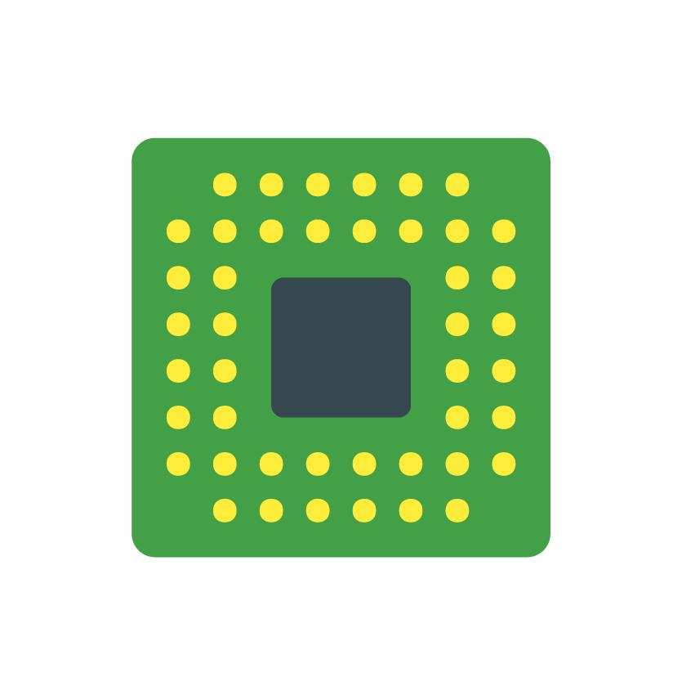
Processors
Central Processing Unit (also known as the CPU or processor) performs the decision and calculations for the Operating System.
Connected to other hardware via the motherboard.
Multiprocessor = system with more than one CPU.
Multi-core = more than one processor on a single chip.

Slide 6
Processors
Two main processor types:
x86 (32 bit)
x86_64 (64 bit)
x86 invented in 1978, x86_64 invented in 2000.
X86 is limited to 4GB RAM.

Slide 7
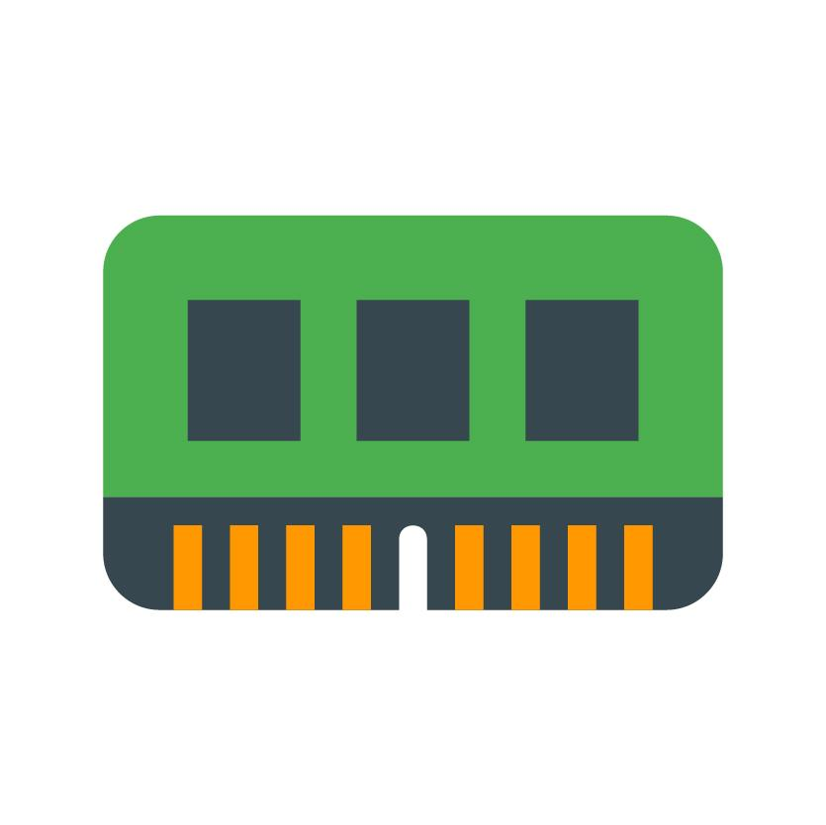
Random Access Memory (RAM)
Random Access Memory (RAM) is where program and system data is stored.
Virtual memory (swap space) is a filesystem type or file that is used when available RAM is low.
The free command can display memory utilization.
sysadmin@localhost:~$ free -m
total used free shared buffers cached
Mem: 128920 56000 72919 0 1181 12110
-/+ buffers/cache: 42709 86211
Swap: 131050 3 131047

Slide 8
Buses
A high-speed connection that allows communication between computers or internal components
Peripheral Devices: Devices not directly attached to motherboard
Two common types:
Peripheral Component Interconnect (PCI)
lspci command
Universal Serial Bus (USB)
lsusb command

Slide 9
Hard Drives
Also called disk devices
Can be connected directly to motherboard, to PCI or USB.
Are divided into partitions, which are logical divisions of a hard drive that take large storage space and break it up into smaller chunks.
Two partitioning types:
Master Boot Record (MBR)
GUID Partitioning Table (GPT)

Slide 10
Boot Records
MBR
Older technology but still commonly used
Tools to view and modify MBR partitions
fdisk, cfdisk, fsdisk
GPT
Newer technology and allows for larger partitions than MBR
Tools to view and modify GPT partitions
gdisk, cdisk, sdisk

Slide 11
Solid State Disks
Type of hard disk that has no moving parts or spinning disks, is effectively RAM or memory
Advantages:
Lower power usage, less heat and vibration, and less time system booting and loading programs.
Disadvantages:
Lower capacity due to higher cost and no ability to upgrade if soldered onto the motherboard.

Slide 12
Optical Drives
Removable storage media often referred to as CD-Roms, DVDs, or Blu-Ray.
Removable drives are mounted on the Linux file system
Older distributions mount drives on /mnt
Newer distributions mount drives on /media or /var/run/media

Slide 13
Managing Devices
How do Linux distributions manage devices? Are the devices compatible?
Hardware devices need software, called drivers, that allows them to communicate with the operating system (OS).

Slide 14
Video Display Devices
Computers need a video display device to display output to an attached monitor.
Video display devices can be built into or attached to the motherboard, as well as connected through PCI bus.

Slide 15
Power Supplies
Devices that convert alternating current (120v, 240v) into direct current that computer uses at various voltages (3.3v, 5v, 12v).
These devices protect the computer from fluctuations in voltage coming from power source.
Desktop and servers are more vulnerable to power fluctuations than laptop computers, which have an internal battery.

